Slide 1
Async await
Basics

Slide 2
Why
You can avoid performance bottlenecks and enhance the overall responsiveness of your application by using asynchronous programming.
Visual Studio 2012 introduces a simplified approach, async programming, that leverages asynchronous support in the .NET Framework 4.5 and the Windows Runtime.

Slide 3
Async Improves Responsiveness
Asynchrony is essential for activities that are potentially blocking, such as when your application accesses the web. Access to a web resource sometimes is slow or delayed. If such an activity is blocked within a synchronous process, the entire application must wait. In an asynchronous process, the application can continue with other work that doesn't depend on the web resource until the potentially blocking task finishes.
The following table shows typical areas where asynchronous programming improves responsiveness. The listed APIs from the .NET Framework 4.5 and the Windows Runtime contain methods that support async programming.
Application area
Supporting APIs that contain async methods
Web access
HttpClient, SyndicationClient
Working with files
StorageFile, StreamWriter, StreamReader, XmlReader
Working with images
MediaCapture, BitmapEncoder, BitmapDecoder
WCF programming
Synchronous and Asynchronous Operations

Slide 4
example
// Three things to note in the signature:
// - The method has an async modifier.
// - The return type is Task or Task<T>. (See "Return Types" section.)
// Here, it is Task<int> because the return statement returns an integer.
// - The method name ends in "Async."

Slide 5
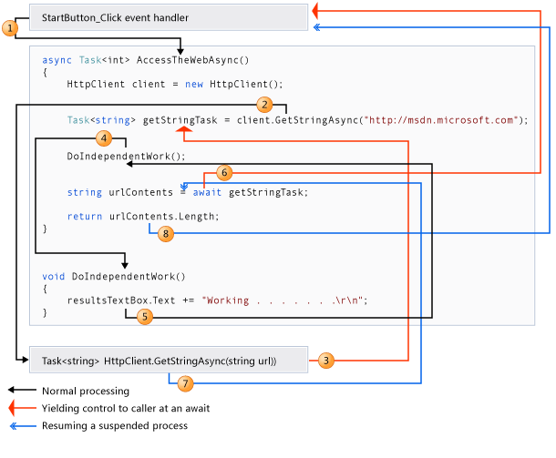

Slide 6
thanks

